Slide 1




Nanocrystalline Soft Magnetics Workshop 2023
Solid State Transformer: From Concept to Pilot Demonstration in a Decade enabled by HV SiC 10-15kV IGBTs and MOSFETs
Magnetics Requirements
August 17th, 2023
Subhashish Bhattacharya, AMPED Director (NCSU)

Slide 2

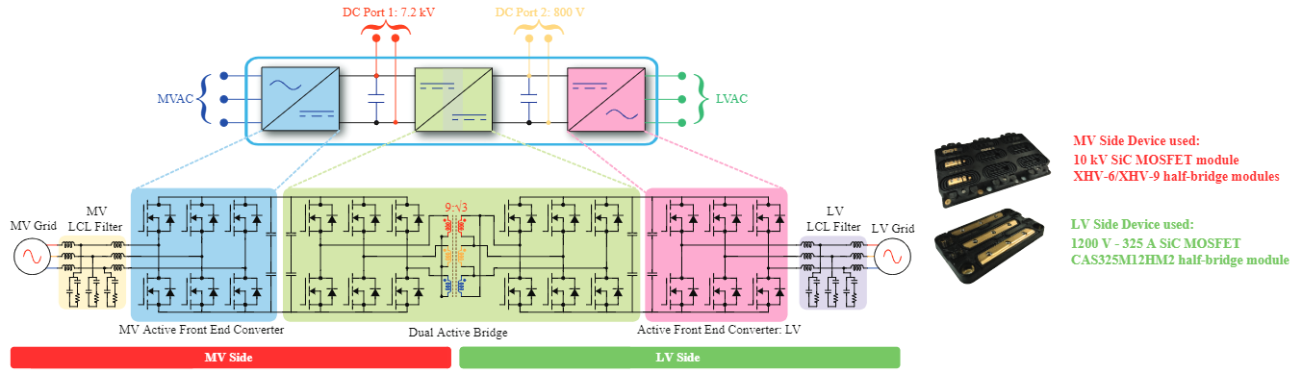
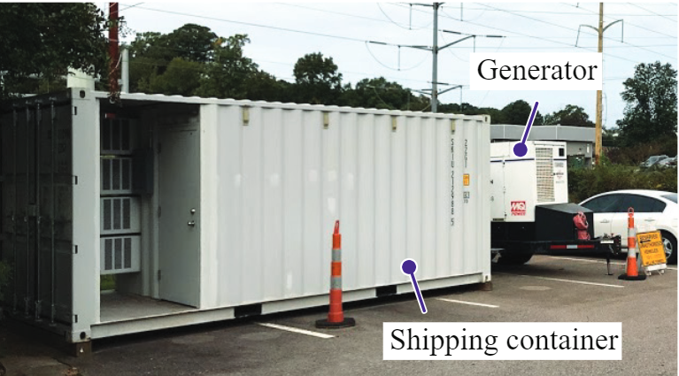
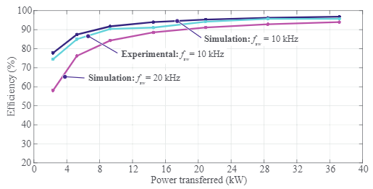
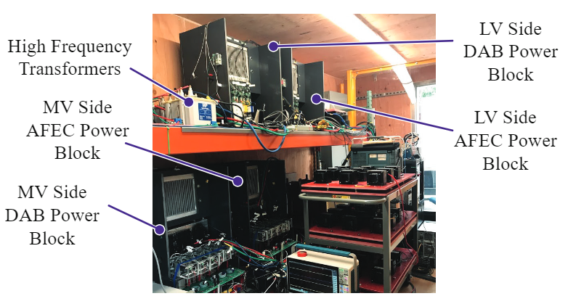
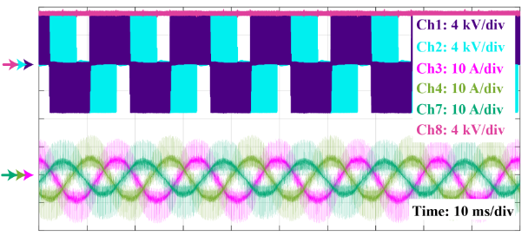
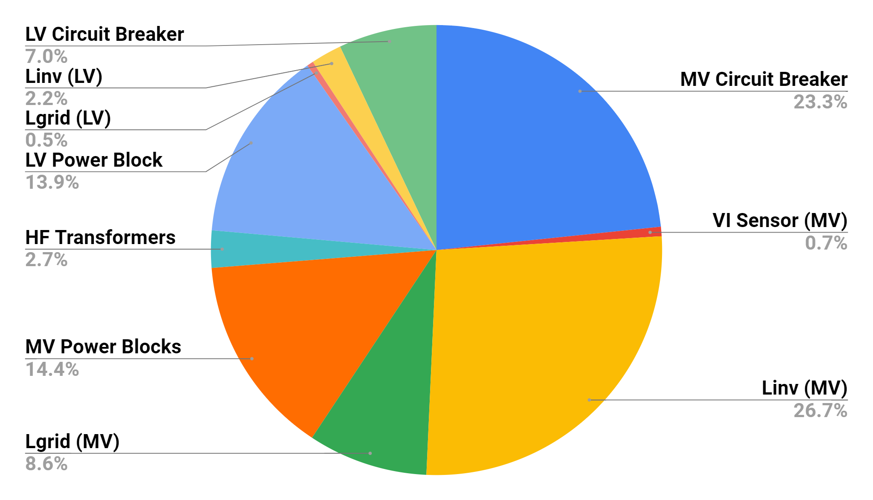
Solid State Transformer installed at Naval Base [Port Heuneme, CA]
SiC 10kV MOSFET based Mobile Utility Support Equipment [MUSE] SST 100kVA, 4.16kV/480V
MUSE SST system container system
Internal dimensions: 4.4 m x 2.33 m x 2.33 m
SST switching frequency: 10kHz (MV AFEC); 20kHz (DAB); 20kHz (LV AFEC)
► Peak efficiency of 96.8%
Efficiency of the MVac/MVdc system
Experimental results of MUSE SST HV converter at a DC-link voltage of 7.2 kV and 10kHz switching frequency (Ch1/Ch2: Line voltage (VYB/VRY); Ch3/Ch4/Ch7: R/Y/B inverter current; Ch8: DC bus voltage)
MUSE SST inside the container
Power Density of MUSE SST
Notes:
Dr. Bhattacharya has been leading the SST development since the start of FREEDM. This is the first time a MV SST as shown in the container has been deployed at a pilot site by an academic laboratory.
This MV SST funded by the Navy has been installed at a Naval Base of Port Heuneme [CA] for Shore to Ship application for the Navy.
The MV SST is based on 10kV SiC MOSFET operating at 7.2kV DC voltage with an efficiency of 96.8% at 38kW and switching at 10-20 kHz.
The MV SST is shown operating inside the container.

Slide 3
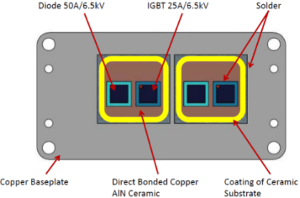
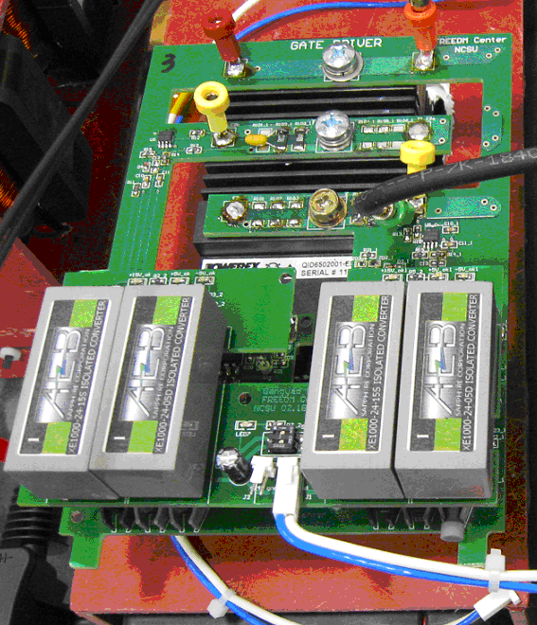
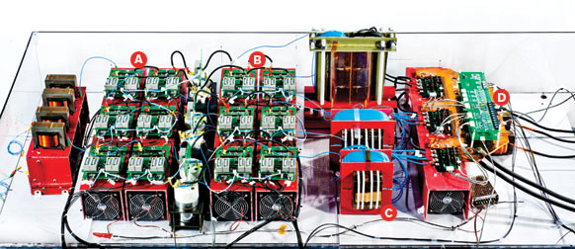

Gen-I SST: Topology & Prototype – 6.5kV Si-IGBT capabilities & challenges
Si-IGBT die: Vces- 6500V; Ice-25A
Vf = 4.2V / 5.4V @ 25ºC/125ºC
Specifications:
Input: 7.2kV
Output: 240Vac/120Vac; 400Vdc
Power rating: 20kVA
EV Charger
Rectifier Stage
DAB Primary
DAB Secondary
Eon@3.8kV, 10A, 25ºC : 64.4mJ
Inverter
Eoff@3.8kV, 10A, 25ºC : 32.7mJ
&
Notes:
3

Slide 4
Magnetics for SST
Magnetic materials
Material | Composition | Loss(w/kg) (10kHz, 0.2T) | Saturation B_{max}[mT] | Permeability (50Hz) | Max working Tem[ºC]
Grain oriented silicon steel | Fe₉₇Si₃ | >1000 | 2000 | 2k-35k | 120
Fe-amorphous alloy | Fe₇₆(Si.B)₂₄ | 18 | 1560 | 6.5K-8K | 150
High performance ferrite | MnZn | 17 | 500 | 1.5K-15K | 100/120
Nanocrystalline alloys | FeCuNbSiB | 4.0 | 1230 | 20K-200K | 120/180
Critical parameters are high saturation flux density and low losses

Slide 5
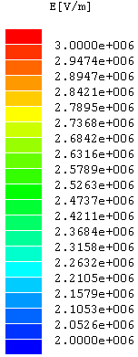
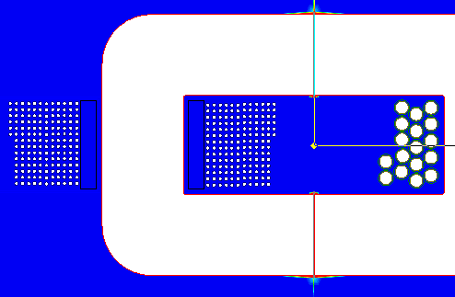
Challenges: HV - HF Magnetics and Transformer design
AC
to
DC
DC
to
AC
PP
Neutral
C1
3.8kV
WP
WS
C2
400V
CP
CS
Polypropylene Material: 0.5mm~1mm
Dielectric strength: ~40kVp/mm, @2mm
Specifications and design parameters:
Frequency: 3 kHz
High voltage DC-link: 3.8kV
Low voltage DC-link: 400V
Power rating: 20/3=6.7kVA
Turns ratio: 9.5
Insulation: 15kV
Number of primary turns:190
Number of secondary turns:20
Magnetizing Inductance: 235mH
Leakage Inductance: 36mH
3.8kV
0V
Electric field distribution (Winding voltage is evenly distributed to each wire in order)

Slide 6
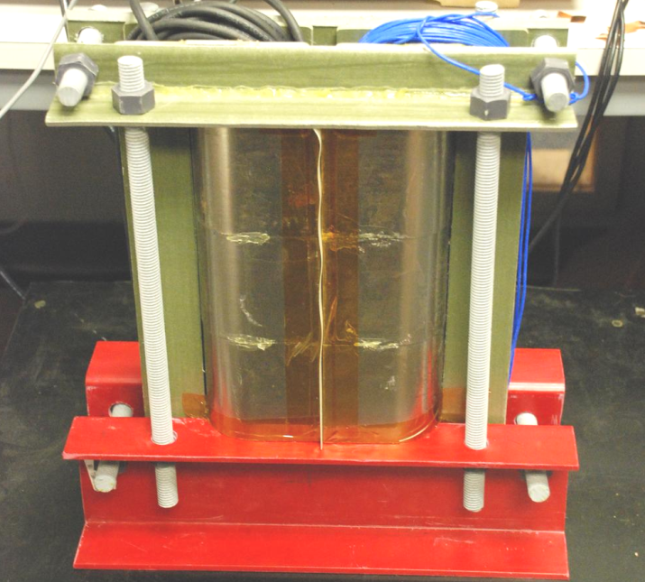
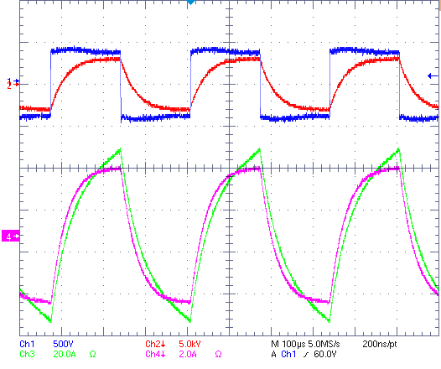
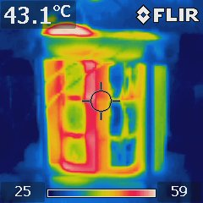
Challenge 3: HV-HF Magnetics -Transformer test
Ch1=Vac_low side;
Ch2=Vac_high side;
Ch3= Iac_low side;
Ch4=Iac_High side,
Test Waveforms
 | 3.9KW | 7.0KW
CORE LOSS (W) | 80.6 | 80.6
HV WINDING LOSS (W) | 16.4 | 62.1
WINDING LOSS (W) | 28.7 | 85.4
TOTAL (W) | 126 | 228
EFFICIENCY | 96.9% | 96.8%
VOLTAGE (KV) | LEAKAGE CURRENT (nA)
10 | 3.6
15 | 5.8
20 | 10.5
25 | 16
Efficiency
Insulation Capability

Slide 7
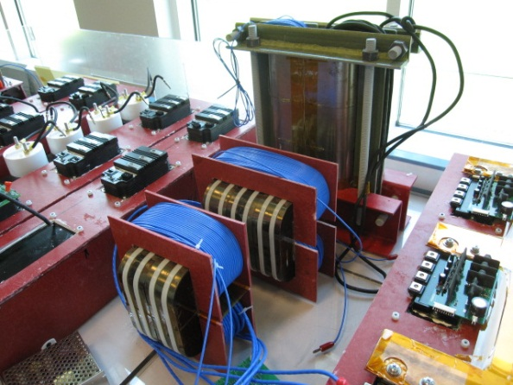

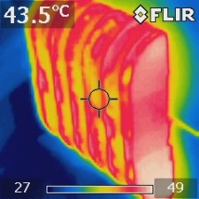
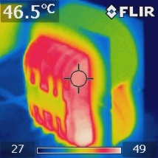
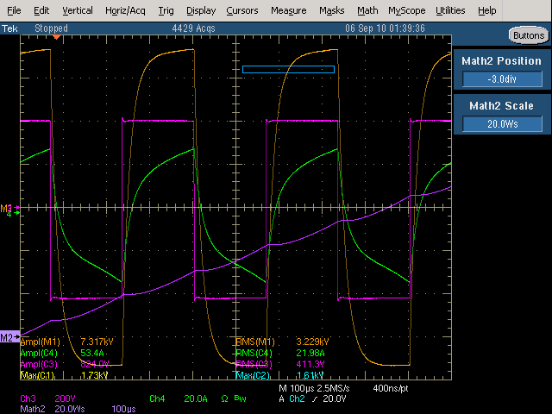
Specification of transformers
SST gen-1
 | prototype-1 | prototype-2 | prototype-3
Core material | Metglas SA2605SA1 | Metglas SA2605SA1 | Metglas SA2605SA1
Operating freq. | 3 kHz
Pin | 7 kW
kVA | 10 kVA
Pri. Volt. | 3800 V
Sec. Volt. | 400 V
Pri. Amp | 2.6 A
Sec. Amp | 25 A
Turns ratio [n:1] | 9.5 : 1
Bac | 0.25 T | 0.26 T | 0.35 T
Ac [cm^2] | 69 | 60 | 40
Window area [cm^2] | 42 | 56.25 | 56.25
Core volume [cm^3] | 3472 | 2706 | 1804
Core mass [kg] | 24.9 | 19.4 | 13.0
# of pri. turns | 190 | 207 | 228
# of sec. turns | 20 | 22 | 24
Airgap [mm] | 0.5 (each side)
Mag. Ind. [mH] | 235 | 468.9 | 341.2
Leak. Ind. [mH] | 36 | 30.3 | 29.7
Excitation current on pri. side | 0.85 A | 0.44 A | 0.59 A
Core loss | 80 W | 100 W | 118 W
Winding loss | 147 W | 94 W | 81 W
Total loss | 227 W | 194 W | 199 W
Efficiency | 96.76 % | 97.3 % | 97.16
Hot spot temp. on the surface with natural convection | 43.1 ºC | 43.5 ºC | 46.5 ºC
prototype-1 (Top), prototype-2 (middle), prototype-3 (bottom)
LV-side voltage (purple,200V/div), HV-side Voltage (orange, 1kV/div) and current (green, 20A/div), Time (100us/div) of Prototype. 3 10kVA HV-HF Transformer

Slide 8
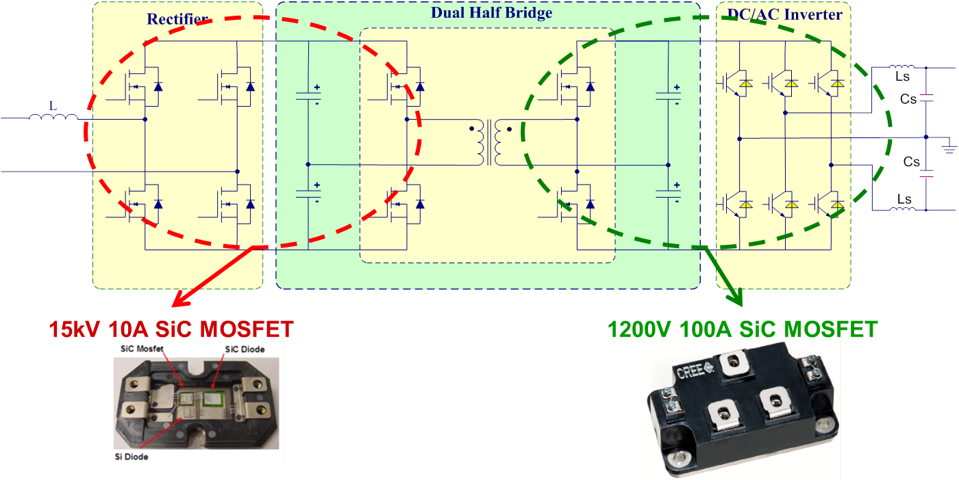
Gen-II SST: Topology – single stage enabled by SiC 15kV MOSFET
Specifications:
Input: 7.2kVac
Output: 240Vac/120Vac; 400Vdc
Power rating: 20kVA
Tested:
Input: 3.6kVac
Output: 240Vac; 400Vdc
Power rating: 10kVA
Notes:
8

Slide 9
Gen-II SST: High Frequency Co-Axial Winding (CWT) Transformer - Design & Test at 20kHz, 30kW, 12kV/400V
30cm*17cm*9cm
DC-DC converter of the SST; 30kVA, 20 kHz CWT test - Yellow (Vo) 5kV/div, pink (Vi) 200V/div, green (Imag) 20A/div; Heat distribution after 90 min operation
Notes:
9
DC-DC converter of the SST; 30kVA, 20 kHz CWT test - Yellow (Vo) 5kV/div, pink (Vi) 200V/div, green (Imag) 20A/div; Heat distribution after 90 min operation
toroid cores used

Slide 10
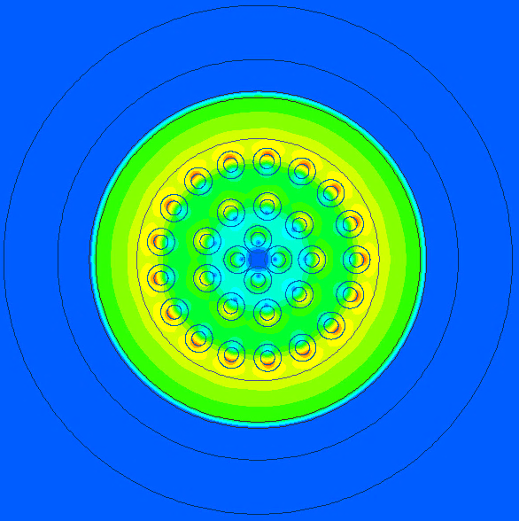
Equivalent Circuit Modeling
Magnetic field distribution and inductance calculation
Leakage inductance $B_{leak φ }$ is only on the inner winding
$$r_{oc o}$$
$$r_{oc i}$$
Mutual flux $B_{m φ}$ is located outside outer winding
Magnetic cores
Outer winding (LV)
Magnetic field intensity in 2D
(the same amount of current on each winding on the opposite direction)
Inner winding (HV)
$$B_{leak φ }=\frac{μ_{o}μ_{r i} N_{i}{ i}_{i}}{2πr}$$
$$B_{m φ }=\frac{μ_{o}μ_{r o} ({ N}_{i}{ i}_{i}−{ N}_{o}{ i}_{o})}{2πr}$$
$$L_{oc }=L_{m }=\int{B_{m φ }}dr [H/m]$$
$$L_{sc }=L_{leak }=\int{B_{leak φ }}drdr [H/m]$$

Slide 11
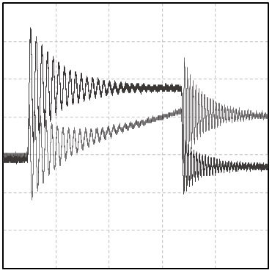
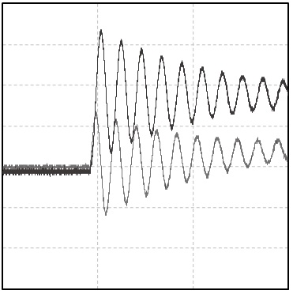
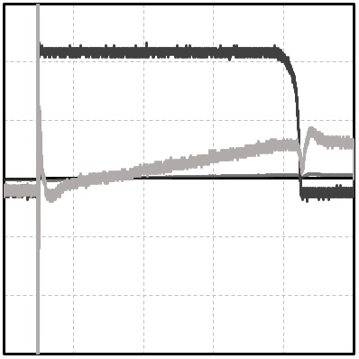
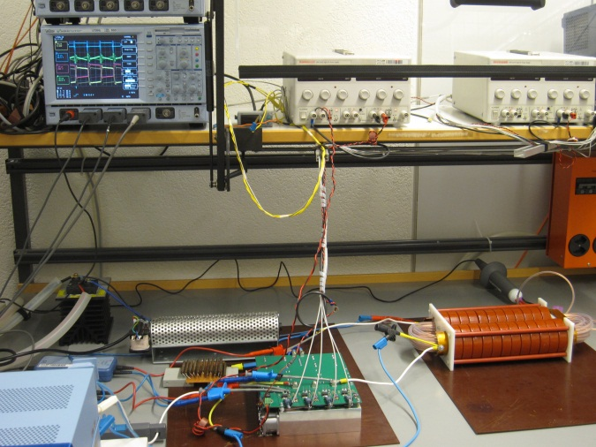
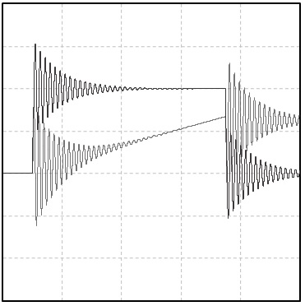
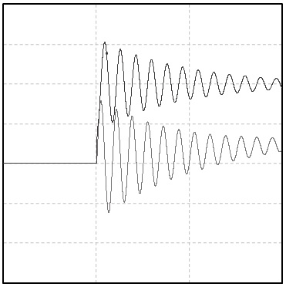
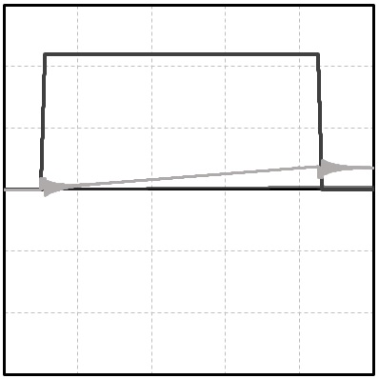
Co-Axial Winding Transformer (CWT) prototype
- Switching response -
Measurement
Excitation on LV winding
Excitation on HV winding
$v_{LV}$, 5V/Div.
$v_{LV}$, 5V/Div.
$v_{HV}$, 100V/Div.
$i_{LV}$, 1A/Div.
$i_{HV}$, 100mA/Div.
$i_{LV}$, 1A/Div.
Ckt. Simulation on the basis of Eq. circuit model
 | $$L_{sc}$$ |  | $$L_{oc}$$
Calculation in 2D | 113nH/m |  | 1.38mH/m
2D FEM | Exact geometry | Simplified geometry | 658uH(1.37mH/m)
 | 108nH/m | 117nH/m
3D FEM | 271nH |  | 658uH
Measurements | 715nH |  | 519uH
 | Common-mode | Ca | Cb | Cc
Calculation in 2D | 125pF | 13pF | 79pF | 47pF
2D FEM | 128pF | 2pF | 89pF | 39F
3D FEM | 137pF | 15pf | 97pF | 40pF
Measurements | 138pF | 16pF | 93pF | 45pF

Slide 12
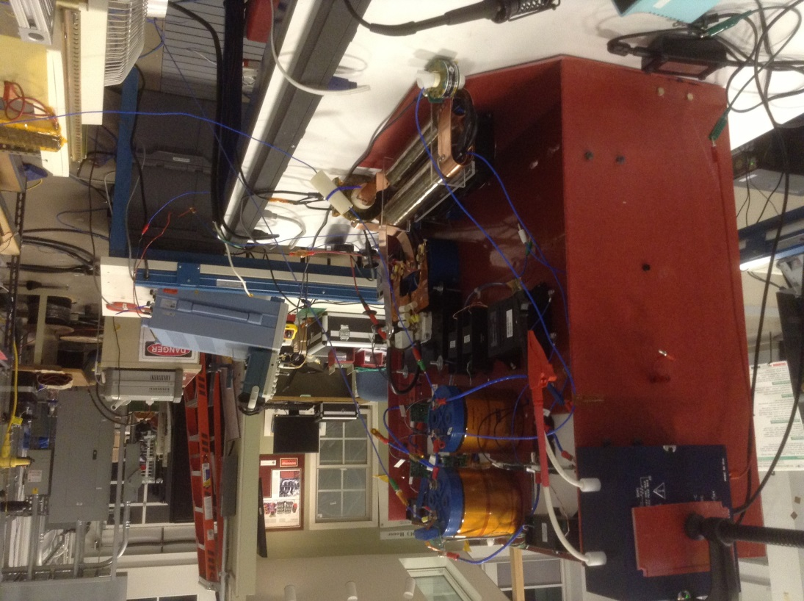
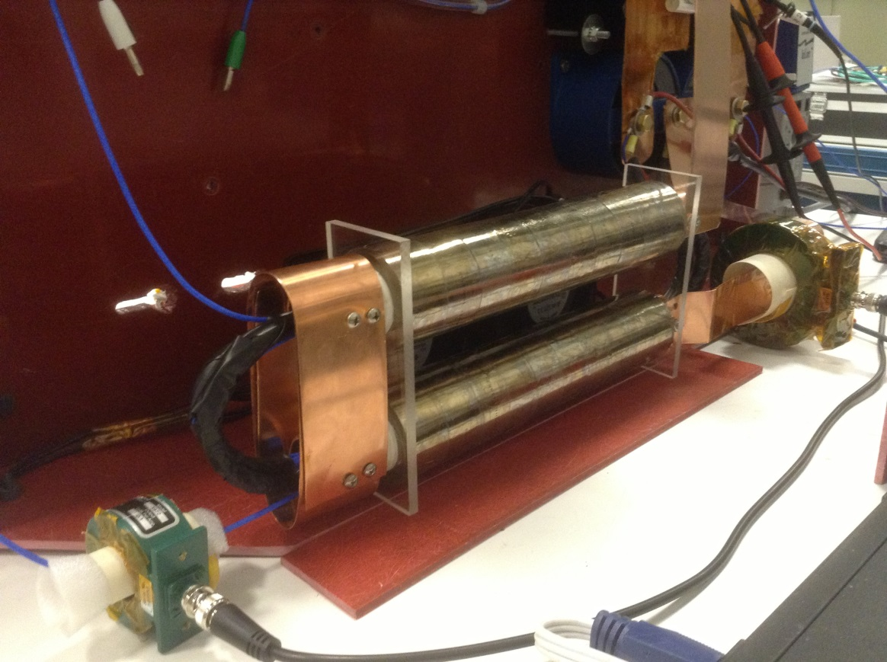
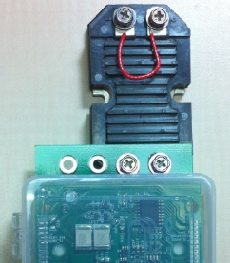
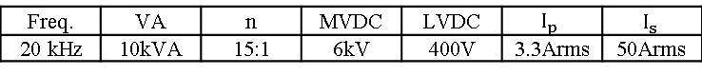
Integrated CWT based SST
13kV SiC MOSFET based SST with Inductor (4mH) integrated coaxial winding transformer
Freq. | VA | n | MVDC | LVDC | $$I_{p}$$ | $$I_{s}$$
20 kHz | 10kVA | 15:1 | 6kV | 400V | 3.3Arms | 50Arms

Slide 13
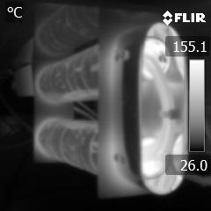
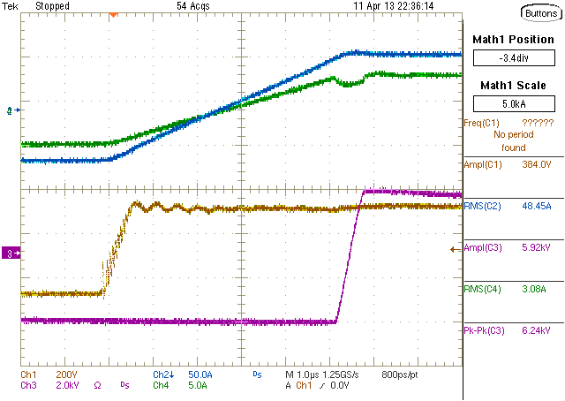
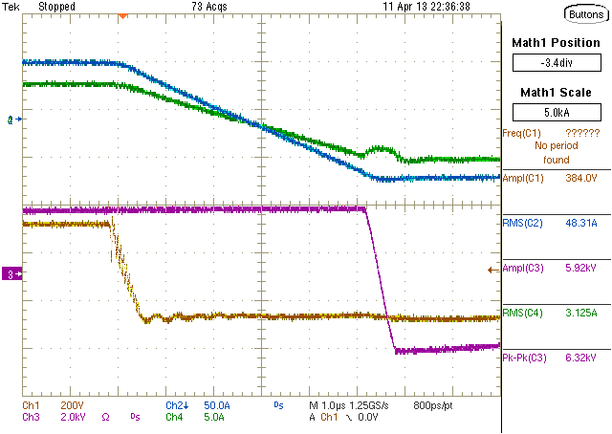
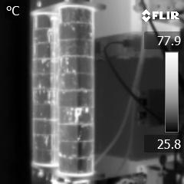
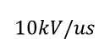

ICWT operation with 6kVdc-400Vdc dc/dc stage of SST
- Waveforms and temperature rise at 6.5kVA-
$$∆i≅1.0A$$
50A/div
200V/div
5A/div
$$10kV/us$$
2kV/div
Waveforms of 6kVdc-400Vdc dc-dc conversion operation at 20kHz.
Heat distribution at 6.5kVA power transfer without an active cooling method after 70 minute operation
Hot spot temperature :170 ℃ after 70 minutes operation with 6.5kVA without active cooling method in dry-type
-The upper temperature limit of wire insulation material, PFA (Perfluoroalkoxy), is 260℃

Slide 14
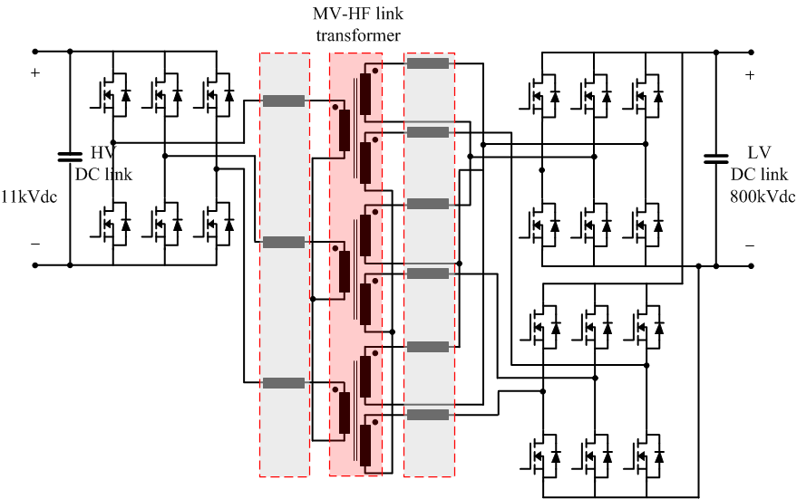
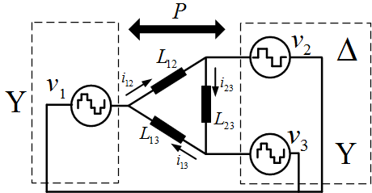
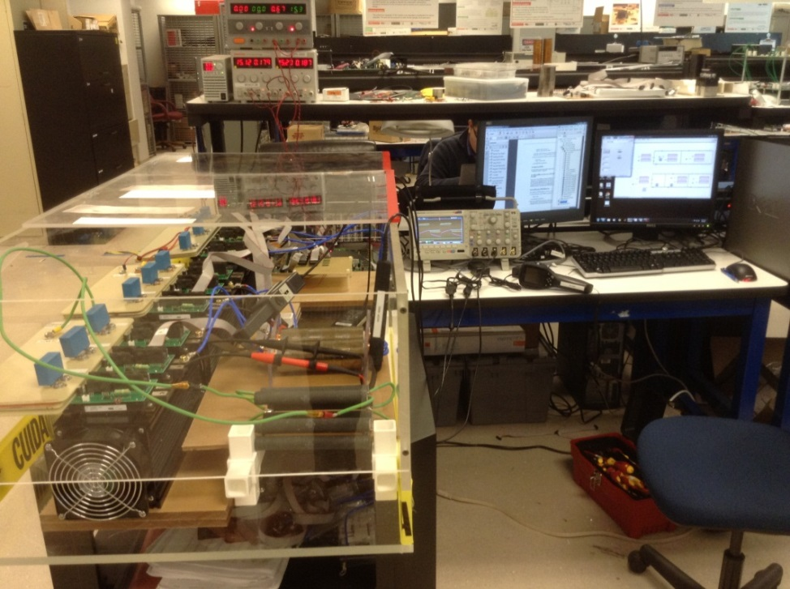
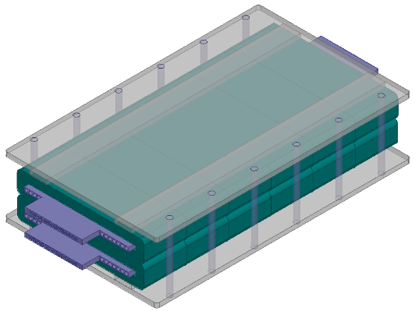
Gen-II 3-phase SST High-Frequency 10kHz Multi-Terminal Planar Transformer
Simplified eq. circuit model
Design to analytically utilize and integrate series inductances on the MV-HF AC link transformer
No additional parasitic elements
No additional space and cost.
Light and compact.

Slide 15
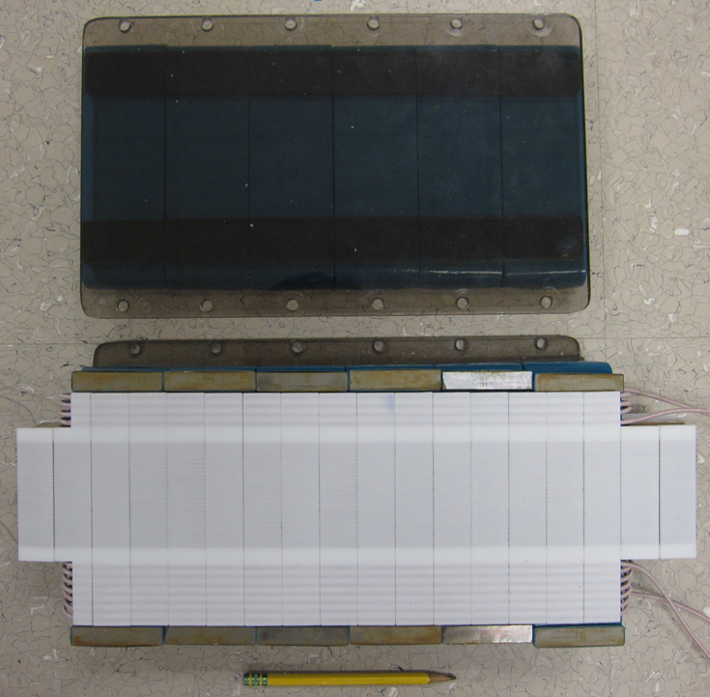
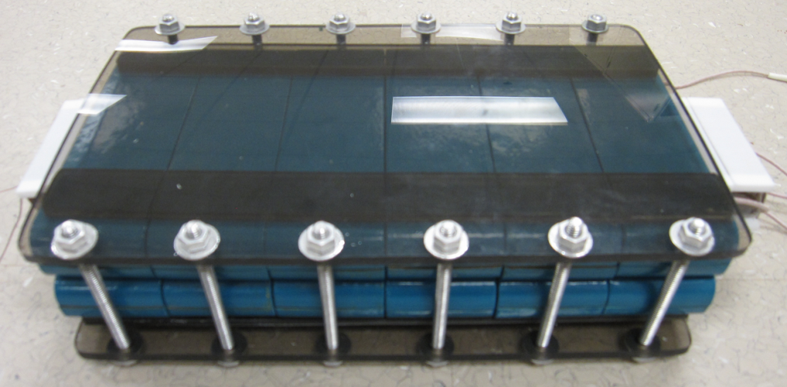
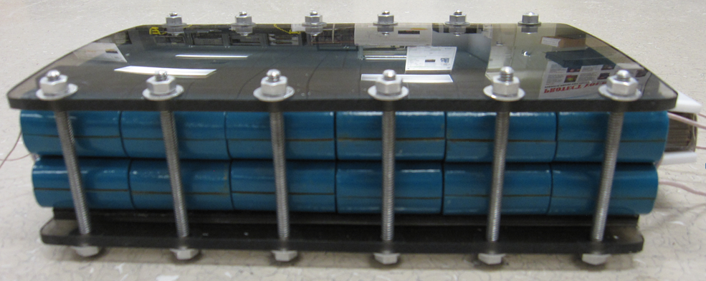
Gen-II 3-phase SST High-Frequency 10kHz Multi-Terminal Planar Transformer

Slide 16


Proposed shell-type low-profile MF/MV transformer
- Prototype-
Freq. | $$V_{dc 1}$$ | $$V_{dc 2}$$ | $${kVA}_{phase}$$
10kHz | 5500V | 400V | 5.5kVA
36cm
18cm
$N_{1}:N_{2}$:$N_{3}$ ($Y:Y:Δ$) | $$V_{phase}$$ | $$B_{ac}$$
55$:7:4$ | 2.6kV | 0.28T
No load loss (Open circuit) | Load loss (Short circuit) | Total loss
40W | 78 W | 118W
7.2cm

Slide 17
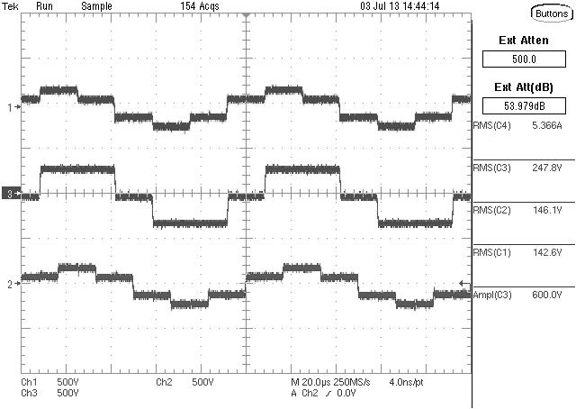
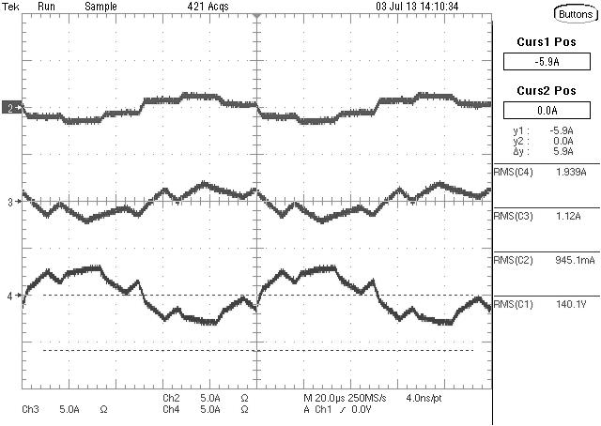
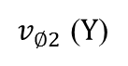
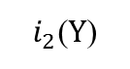
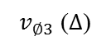
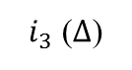
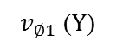







Experimental results
- Operation test, waveforms -
Voltage waveforms on each winding with $θ_{ps}=30°$
Line current waveform with $θ_{ps}=10°$
3 of 1/3 size prototype
Line current waveform with $θ_{ps}=20°$
Line current waveform with $θ_{ps}=30°$
Waveforms (500V/Div, 5A/Div, 20us/Div)

Slide 18



Introduction
- Transformers -
1. The best known geometry regarding LC characteristics!
1. Easy utilization of leakage inductance by geometric factor !
w=width of window area
h=height of window area
l = length of window area
2. Ideal geometry with no electric, magnetic field and heat congestion.
2. Electrically and magnetically well shielded.
3. Low parasitic elements
4. Electrically and magnetically well shielded.
3. Simple geometry.

Slide 19







Mobile Utility Support Equipment (MUSE) SST [Navy ESTEP Program]: Ship to Shore SST; ac grid tie for large manufacturing facilities
Three High Frequency Transformers
Mobile container
Photograph of the entire MUSE-SST system in the laboratory
Photograph of the entire MUSE-SST system in the
mobile container
Demonstration of the entire MUSE-SST system in the mobile container

Slide 20





Final Operation of the Entire MUSE-SST System
► Operation at 3.5 kV MVDC; 600 V LVDC and an active power of 28 kW
Ch1: LV pole voltage (VRY); Ch2: LV voltage across filter capacitor (VRY-cap); Ch3: Current through LV R-phase; Ch4: Current through LV Y-phase.
Ch1: MV DC-link voltage (Vdc-MV); Ch2/Ch3: MV pole voltage (VRY/VYB); Ch4/Ch5: Inverter current through MV R/Y-phase; Ch6/Ch7: Grid current through MV R/Y-phase.
Ch1: LV DC-link voltage (Vdc-LV); Ch2: MV pole voltage (VRY-MV); Ch3: LV pole voltage (VRY-LV); Ch4/Ch5: Current through MV R/Y-phase; Ch6/Ch7: Current through LV R/Y-phase.
Ch1: LV pole voltage (VRY); Ch2: DC-link voltage across inverter; Ch3: Current through LV R-phase; Ch4: Current through LV Y-phase.

Slide 21




Final Operation of the Entire MUSE-SST System
► Operation at 7.2 kV MVDC; 600 V LVDC and an active power of 30 kW
MV-AFEC system for a peak current of 25 A.
(Ch1/Ch4: MV pole voltage (V-RY/V-YB); Ch2: Grid current through R-phase; Ch3/Ch7: Inverter current through MV R/Y-phase; Ch8: MV DC-link voltage
MV-AFEC system for a peak current of 30 A.
(Ch1/Ch4: MV pole voltage (V-RY/V-YB); Ch2: Grid current through R-phase; Ch3/Ch7: Inverter current through MV R/Y-phase; Ch8: MV DC-link voltage
► Operation of 3-phase DAB as MVdc/LVdc stage at higher voltages and different operating conditions
Phase shift: 20º
R load: 12.5 Ω
Input voltage: 7200 V
Power transfer:
17.5 kW
Phase shift: 30º
R load: 12.5 Ω
Input voltage: 7200 V
Power transfer:
30.5 kW
(Ch1/Ch6: Line-to-line voltage of MV/LV side (VRY); Ch2/Ch4: R/Y-phase LV side current; Ch3/Ch7: R/Y-phase MV side current; Ch5/Ch8: MV/LV side DC-link voltage)

Slide 22
High Frequency Transformers Design and Characterization

Slide 23




DAB Converter System
► Dual Active Bridge (Power flow from MV side to LV side)

Slide 24
Testing the High Frequency Transformer
► Characterizing and testing the HFTs
► HFT is manufactured by IAP Research
► Characterization is carried out using an impedance analyzer
► Dimensions: 11.5 inches x 9.5 inches x 7 inches. Filled weight: 42 lbs
Parameters | Value
Turns Ratio | 9 : 1.732
RMS AC voltage rating | 3395 V/656 V
Peak AC voltage rating | 4800 V/805 V
RMS AC current rating | 22 A/55.24 A
Peak AC current rating | 30 A/83 A
Nominal Frequency | 20 kHz
Leakage Inductance (referred to HV side) | 1.8 mH
Magnetizing Inductance (referred to HV side) | > 300 mH
Isolation design | 20 kV
Isolation capacitance (primary to secondary) | <1000 pF
Specifications of the HFT for the Dual Active Bridge converter system
Photograph of the HFT used in the Dual Active Bridge converter system. Dimensions: 11.5 inches x 9.5 inches x 7 inches. Filled weight: 42 lbs
► Insulation tested up to 15kV
► Core material : nanocrystalline
► Filled with oil to achieve the required insulation level and thermal cooling
► Transformer design is very challenging to meet size, minimal parasitics and high magnetizing inductances

Slide 25



High Frequency Transformer Characterization and Modeling
► Three high-frequency transformers (Operating frequency 20 kHz)
► Manufactured using nanocrystalline core
► Insulation and thermal management is provided by transformer oil
► Small hole is provided on top to monitor and replace the transformer oil when necessary
► Transformer houses the series-connected inductors in the same structure
► Design is very challenging to meet size, minimal parasitics and high magnetizing inductances
► Characterization and modeling of the high frequency transformer (HFT)
► Characterized using HP 4294A impedance analyzer
► Impedance analysis for measuring various parameters including the parasitic elements
► Short-circuit measurement, open-circuit measurement and coupling capacitance measurements
Photograph of the high frequency transformer
Dimensions: 11.5 inches x 9.5 inches x 7 inches. Filled weight: 42 lbs
Inductance measurement curves of MV side inductor
Inductance measurement curves of LV side inductor
Isolation capacitance of the primary to secondary winding
¹ A. Anurag, S. Acharya, S. Bhattacharya, T. R. Weatherford and A. Parker, "A Gen-3 10 kV SiC MOSFETs based Medium Voltage Three-Phase Dual Active Bridge Converter Enabling a Mobile Utility Support Equipment Solid State Transformer (MUSE-SST)," in IEEE Journal of Emerging and Selected Topics in Power Electronics, doi: 10.1109/JESTPE.2021.3069810.

Slide 26





High Frequency Transformer Characterization and Modeling
► Characterization and modeling of the high frequency transformer
► Impedance analysis for measuring various parameters including the parasitic elements
► Short-circuit measurement, open-circuit measurement and coupling capacitance measurements
Equivalent model of the high frequency transformer
Key parameters of the high frequency transformer
Impedance curves of primary winding with secondary side shorted
► Calculate the respective capacitance and inductance using:
Impedance curves of primary winding with secondary side open
¹ A. Anurag, S. Acharya, S. Bhattacharya, T. R. Weatherford and A. Parker, "A Gen-3 10 kV SiC MOSFETs based Medium Voltage Three-Phase Dual Active Bridge Converter Enabling a Mobile Utility Support Equipment Solid State Transformer (MUSE-SST)," in IEEE Journal of Emerging and Selected Topics in Power Electronics, doi: 10.1109/JESTPE.2021.3069810.

Slide 27







50kW DC-DC Dual Active Bridge [DAB] Converter [400V: 1000V]

Slide 28


Coaxial Transformer: Tubular Winding Capacitance
Layered secondary windings have increased self capacitance, but careful winding selection can minimize capacitive stored energy.
Assume:
- Flat plate capacitance is dominant.
- Layer-to-layer and layer-to-core capacitance is the same.
Capacitive shielding of inner winding layers results in minimal capacitive stored energy.
core
3
7
4
8
2
3
6
7
1
5
1
4
5
8
2
6
Capacitance model of optimal 8-turn, 2 layer winding
Winding order of optimal 8-turn, 2 layer winding

Slide 29


Optimal Co-Design of DAB: 50kW results
Selected Design
O

Slide 30






System Build
Detail of foil end connections, insulation, and primary Litz winding
Controller communications and fault response testing
Welded foil end connections resulted in winding resistance only 15% higher than ideal
Composite winding tube has direct copper-air cooling
Second composite tube prior to transformer assembly
System components (except controller) on build plate

Slide 31
1000V/ 20kW MVDC Contactless Power Supply
Specification | Value
Nominal Input Voltage | 1000V
Nominal Output Voltage | 48V
Nominal Output Current | 400A
Rated Power | 20kW
Efficiency Target | 95% @ 50% Load 91% 100% Load 90% @ 20% Load
- 1000V chosen for validation phase - Opens the pathway to 2000V, 4000V, 8000V

Slide 32







Gapped Transformer Design Overview
LV Side Assembly
Unplugged
HV Side Assembly
Inserted

Slide 33


Integration of PV and ESS using TAB
Three-Limb split winding transformer.
PV and ESS windings are split into two equal halves on the side two limbs.
Two equal halves have same number of turns and the geometric dimension of the limbs are also same.
Transformer design is optimized based on the loss-volume using a leakage inductance and parasitic capacitance model.
Two laboratory prototypes were built for 50kHz and 100kHz switching frequency.
Pareto Front
50 kHz prototype
100 kHz prototype

Slide 34








4.2 Inverter-fed High-Speed Motor Drive Efficiency Evaluation (In Progress)
Six-phase 3L-ANPC inverter
High-speed PMSM setup
Motor details
Motor drive test result at 6000 RPM 0.7PU load
Motor drive test result at 9000 RPM no load
V_{rn} (pole voltage): 500V/div
V_{rn} (pole voltage): 500V/div
V_{yb} : 500V/div
V_{yb} : 500V/div
Test results are with Six-phase 3L-ANPC inverter (1dev/switch)
Switching frequency: 50kHz
Six-phase PMSM is controlled using dual three phase-based vector control [4].
Control algorithm is implemented is TI DSP F28379D.
I_{r}, I_{u} 5A/div/div
I_{r} :2A/div/div
I_{r}
I_{u}
I_{u} :2A/div/div
Time scale: 2ms/div
Time scale: 2ms/div
V_{dc}: 350V
Fundamental frequency: 400Hz
Six-phase input ≈ 1kVA
V_{dc}: 450V
Fundamental frequency: 600Hz
[4] P. P. Das, S. Satpathy, S. Bhattacharya and V. Veliadis, "Generalized Control Technique for Three-Level Inverter Fed Six-Phase Permanent Magnet Synchronous Machines Under Fault Conditions," 2022 IEEE Energy Conversion Congress and Exposition (ECCE), Detroit, MI, USA, 2022, pp. 1-8, doi: 10.1109/ECCE50734.2022.9947672.

Slide 35




High speed machine (HSM) testbeds
Motor
Torque transducer
Generator
LV HSM-1
LV HSM-2
LV HSM-3
MV HSM-4
 | LV HSM-1 Testbed 1 | LV HSM-2 Testbed 2 | LV HSM-3 Testbed 3 | MV HSM-4 Testbed
Power | 1.39kW | 5kW | 10kW | 15kW
Voltage (L-L) | 400V (3ph-3ph M-G set) | 560V (3ph-3ph M-G set) | 565V (Open winding, 3ph and 6ph M-G set); one HSM is 3-phase and other 6-phase | 1100V (Open winding, 3ph-3ph M-G set)
Poles | 10 | 4 | 8 | 6
Speed | 14,000rpm | 30,000rpm | 21,000 rpm | 25,000 rpm
Fundamental frequency | 1167Hz | 1000Hz | 1400 Hz | 1250Hz

Slide 36

15kV SiC IGBT based 3-phase SST with 13.8kV MV AC grid tie: Transformerless Intelligent Power Substation (TIPS)
Three-Phase SiC Devices based Solid State alternative to conventional line frequency transformer for interconnecting 13.8 kV distribution grid with 480 V utility grid.
Smaller and Light Weight High Frequency Transformer operating at 10 kHz used for Isolation.
Advantages – Better Power Quality, Controllability, VAR Compensation, Small Size/Light Weight, lower Cooling Requirement, Integration of Renewable Energy Sources/Storage System

Slide 37





TIPS Converter Laboratory Demonstration: AFEC waveforms for 4.16 kV MV AC grid tie operation with 8 kV MV dc bus and 9.6 kW load
FEC grid currents and R-phase pole-voltage
70kVA, 10kHz, 22kV/11kV/800V Transformer
1200V SiC MOSFET LV Side Converter
RY-grid voltage and R-phase grid current

Slide 38



TIPS Converter Laboratory Demonstration: DAB waveforms for 4.16 kV MV ac grid tie operation with 8 kV MV dc bus, 480 V LV dc bus voltage and 9.6 kW load
HF Transformer Equivalent Circuit Parameters with Parasitic Capacitors
65 kg dry
95 kg oil filled
11”
All waveforms captured at the HF transformer terminals
Ripple in the DAB currents is due to the HF transformer parasitics
20.5”
14”
70kVA, 10kHz, 22kV/11kV/800V Transformer

Slide 39
MV – Medium Frequency Transformer Specifications
Parameter | Values
Power | 35/70 kVA,11 kV/22 kV dual mode
Primary | 9.6 kV RMS, 16.6 kV peak,8 A RMS, 12A peak
Secondary – Y winding 1 ,2 | 360 V RMS , 605 V peak,52 A RMS, 83 A peak
Secondary – Delta winding 1 ,2 | 625 V RMS , 1050 V peak,31 A RMS, 46 A peak
Frequency | 10 kHz
Leakage inductance | 80 µH (from secondary side)
Magnetization inductance | 280 mH (from primary side), Max. magnetizing current 15% of full load current
Parasitic capacitance (inter turn from primary) | <500 pF
Isolation primary to secondary | 100 kV RMS
Cooling | Oil cooling
Efficiency | >99%
Turns ratio, switching frequency, leakage inductance are selected for optimum operation of DAB

Slide 40




Medium Frequency Transformer for DAB
Y2
D2
Yr
D1
P
Y1
Pr
Yy
Yb
Py
Pb
11”
Dr
Db
Dy
22/11 kV, 10 kHz, 70 kVA 1-Φ Transformer
Transformer Connections
20.5”
Insulation tested up to 22kV
Oil filled transformer
Three 1-Φ transformers are connected in Y/Y-Δ for 3-Φ DAB
14”
65 kg dry
95 kg oil filled

Slide 41


Transformer Winding Arrangement and Equivalent Circuit with Parasitics
HF Transformer Equivalent Circuit Parameters with Parasitic Capacitors
Transformer Winding Arrangement

Slide 42


Verification of Measured Equivalent Circuit using Spice Simulation
Open Circuit Secondaries
Actual Impedance Plot using Impedance
Analyzer
Impedance Plot using Spice Simulation

Slide 43


Verification of Measured Equivalent Circuit using Spice Simulation
Short Circuit Secondaries
Actual Impedance Plot using Impedance
Analyzer
Impedance Plot using spice Simulation

Slide 44




Hardware Demonstration
ΔY connected 2L-3L DAB3 converter
Hardware prototype of the ΔY connected 2L-3L DAB3 converter
Table: Specifications for the Hardware Setup
*Balancing Resistors of 50 kOhm are implemented on the secondary side.
Steady-state waveforms of ΔY connected Two-level to Three-level Three Phase Dual Active Bridge (2L-3L DAB3) at a rated power of 5 kW and the operating point (D2, ϕ) = (0.34, 23.8°).

Slide 45







Open-circuit Fault in DAB3
Causes volt-sec imbalance across phase inductors
Produces DC bias in AC phase currents $\left(i_{A},i_{B}, i_{C}\right)$
Effect of primary side fault >> secondary side fault
All the results shown here are experimental results.

Slide 46






Effect of Open-circuit Fault on the Transformer
No-fault mode
No dc bias
Balanced around (0,0)
BH loops overlap
Fault mode
DC bias
Movement away from (0,0)
Saturation!
Non-trivial relationship $\left(τ≠\frac{L_{mX}}{R_{winding}}\right) τ=f\left(φ,\frac{L_{mag}}{L_{leak}}, Dead time\right)$
First of its kind study for isolated dc-dc converters!

Slide 47





Monolithic SiC-based Bidirectional FET (BiDFET) Switch: 1200V, 20A DIE
Monolithic BiDFET cross-section
4-terminal Monolithic BiDFET circuit schematic
Fabricated BiDFET die:
Comparison of fabricated 1.2 kV 20 A BiDFET with previous bidirectional switch implementations
Custom-made 4-terminal package for the BiDFET:
Notes:
In This paper, we report the first large area Bidirectional FET, consisting of two adjacent JBSFETs fabricated at the commercial foundry X-Fab. The cross-section of the internal JBSFET is shown here. These are the pictures of the fabricated die and the custom-made 4-terminal package. In this work, we show that our fabricated device provides a monolithic, single-package solution for bidirectional switch implementation with much smaller on-state voltage drop of 1 V at 20 A, compared to the previous bidirectional switch implementations.

Slide 48



Cyclo-converter based 1-phase and 3-phase grid connected PV inverter enabled by Monolithically integrated SiC 4-QPS at 1200V, 10-25A * Advanced packaging of single switch module and half-bridge switch module
Monolithic SiC BiDFET enabled grid-connected power conversion system for PV
Elimination of DC electrolytic capacitors
Capacitors required are filter capacitors which are film capacitors (small VA rated, available for high ripple current with low ESR)
All switches shown can be SiC 4-QPS – hence standardized modules
(a)
(b)
(c)
Figure 1: (a) Conventional power architecture for DC-AC conversion, (b) High-frequency link single phase inverter using 4-QPS enabled cyclo-converter (c) High-frequency link 3-phase inverter using 4-QPS enabled cyclo-converter.

Slide 49


2.1 kW, 1-ph grid connected converter prototype enabled by 1200V, 20A SiC BiDFET
High frequency transformer voltages/current and grid side current at 100% load at 240 V AC voltage.
Full load operation at 400V input, 240V RMS output at 2.1 kW
Total harmonic distortion in grid-side current: 4.8%
Power factor: 0.9998
Hardware prototype of the AC/DC DAB converter

Slide 50





BiDFET (or 4-QPS) based AC-DC converter development
10 kW, 3-ph PV inverter prototype enabled by 1200V, 20A BiDFET half-bridge module
Operating waveforms at 240 V, 2.5 kW AC output with 400 V DC input.
(AC current THD = 3.9%)
[BiDFET module based phase-leg PCB]
Efficiency and AC currents THD as measured using Hioki Power Analyzer PW6001.

Slide 51



BiDFET (or 4-QPS) based AC-DC converter development
10 kW, 3-ph PV inverter prototype enabled by 1200V, 20A BiDFET half-bridge module
Operating waveforms at 480 V, 10 kW AC output with 800 V DC input.
(AC current THD = 3.5%)
Efficiency variation with load.
Around 0.4% efficiency is forgone to achieve isolation.

Slide 52

Collaboration with industry – please join AMPED
Reference designs for different applications
Applications: EV Charging, EMI filters, CMC filters,
DC-DC converters, Server power supplies for Data Centers
Thank You!!!
Questions
https://research.ece.ncsu.edu/bhattacharya/
https://ece.ncsu.edu/people/sbhatta4/
Email: sbhatta4@ncsu.edu
Ack to all my PhD students, UG Research students and Post-Doctoral Scholars in my group

